Slide 1
NASIS 6.0
Where did all this data come from? Or
How did we get here?
Notes:
This presentation was created to answer the many questions that soil scientists have asked about how and when the NASIS data was created. The questions will be answered.

Slide 2
Pre - 1972 – Soil Survey Interpretation Record
Use the slide show to view the next two slides
Notes:
Before 1972 the Soil Survey Interpretations Record was part of the official series description. Data was hand written or typed in to a form for each series. The form concentrated on engineering data and interpretations. Each Soil Survey Interpretations page was attached to the Official Series Description. This form evolved over the years.

Slide 3
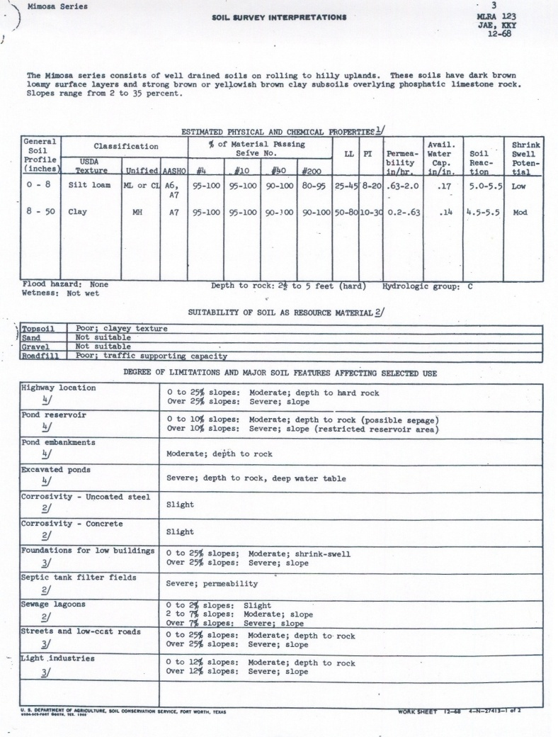
Pre - 1972 – Soil Survey Interpretation Record
Notes:
Here is an example of the Mimosa series “original Soils-5” data. Notice the limited set of data that was made available for use. Also, notice the original intent – engineering properties.

Slide 4
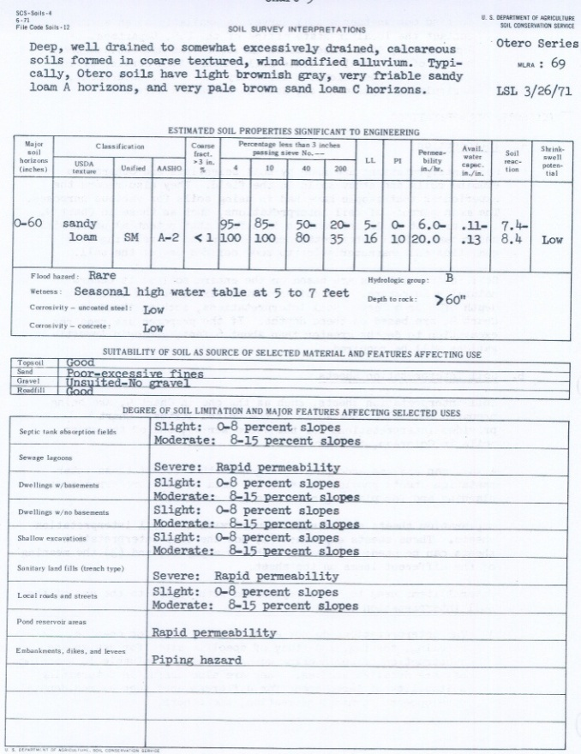
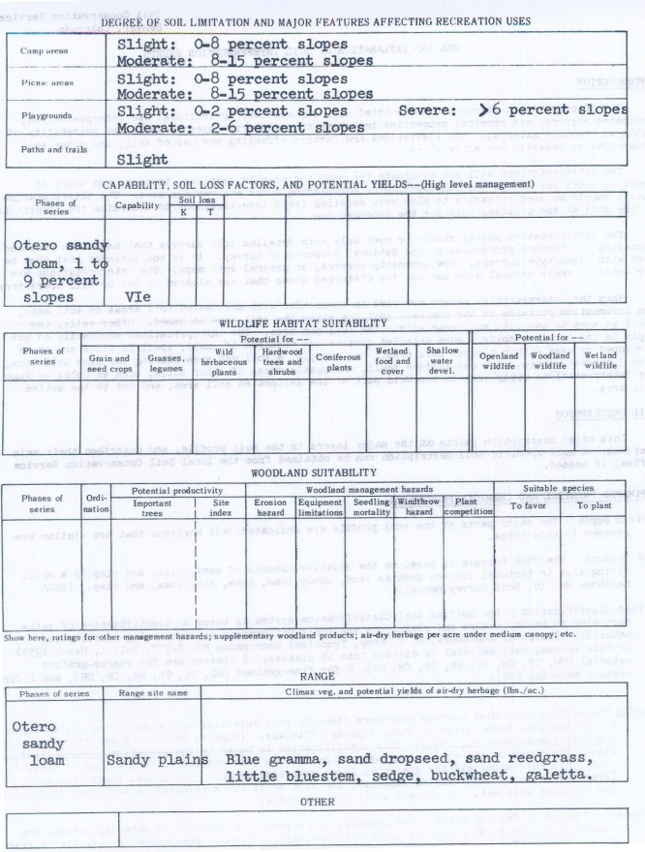
Pre - 1972 – Soil Survey Interpretation Record
Notes:
This is an example of the pre-1972 SOILS-5 form for the Otero series. Notice the limited amount of data.

Slide 5
1972 Soil Survey enters the Computer Age
Entry forms created
SOI-5
SOI-6
Data stored in mainframe at the Statistical Laboratory at Iowa State University
In 1974, the generation of manuscript tables of soil properties for inclusion in soil survey reports was introduced. Initially, all data processing was done locally at ISU, and hard copy was sent through the mail. The SOI-5 forms and the SOI-6 forms, used to enter map unit information for the soil surveys, were mailed from SCS offices to ISU for processing. Printed copies of revised records and generated tables were mailed back to SCS.
Notes:
I can’t improve on the description found in “United States Soil Survey Databases” edited by J.R. Fortner and A.B. Price USDA-NRCS in 2009:
“The NRCS first established a national soil database in the early 1970s through a cooperative agreement with the Statistical Laboratory at Iowa State University (ISU). ISU was chosen because of its long history of cooperative work with the Soil Conservation Service (SCS), dating back to the 1940s. Programming work for a soil database began in 1972 with automation of the soil interpretations records or Form SOI-5, which was used primarily as an input form to generate tables on engineering uses of soils for soil survey reports. Computer programs were developed to store, check, and print the data. The record for the Cecil soil series (NC0018) was the first one stored on the ISU mainframe in 1973. “

Slide 6
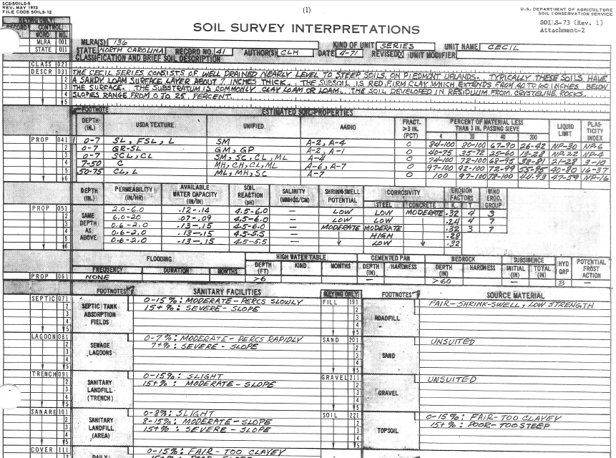
Notes:
Here is the original Cecil S-5 entered into the mainframe.

Slide 7
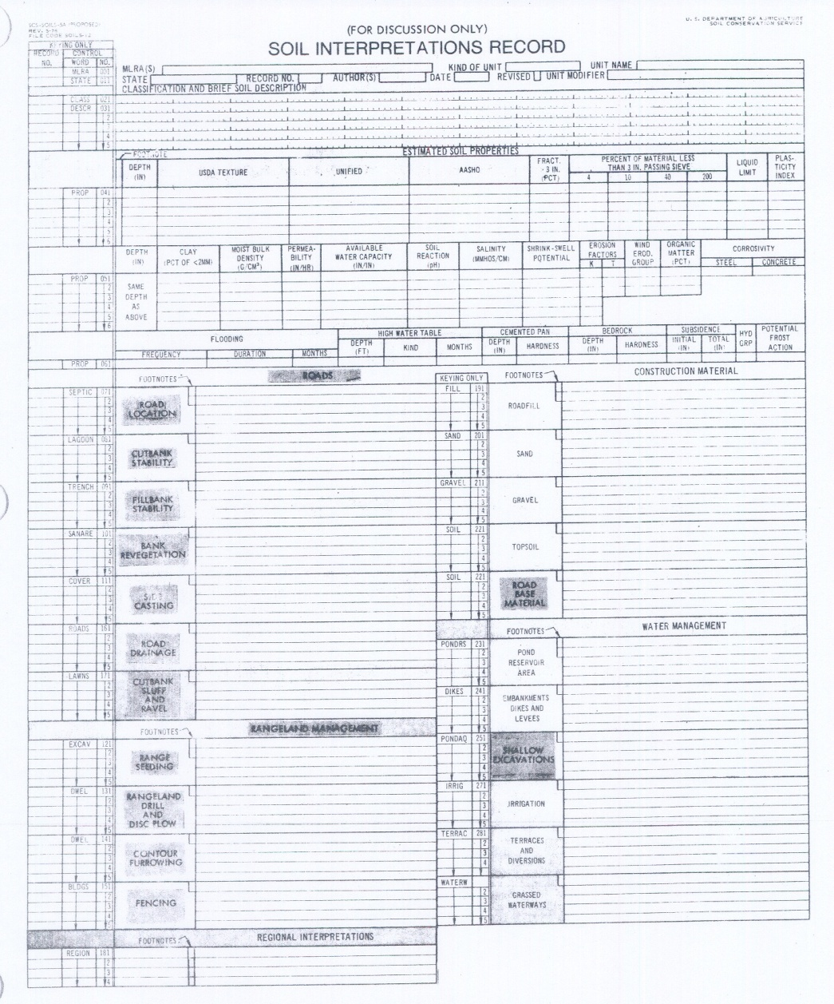
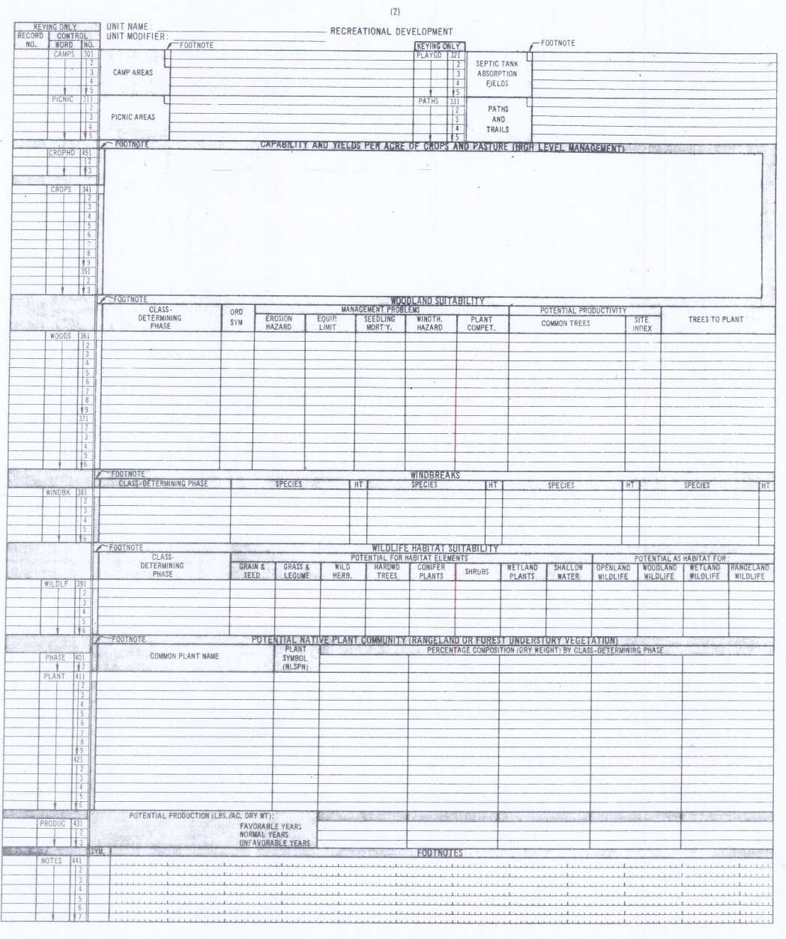
1972 - SOI-5 “Series Interpretation Record”
Notes:
The Series Interpretation Record or Form SOI-5 was created as an input form. The form was used to populate the soils properties to be entered in the ISU main frame. The form was filled out by the correlator and mailed to Ames, Iowa. ISU Statistical staff keypunched the information into the main frame computer. Reports were retrieved and returned via mail.

Slide 8
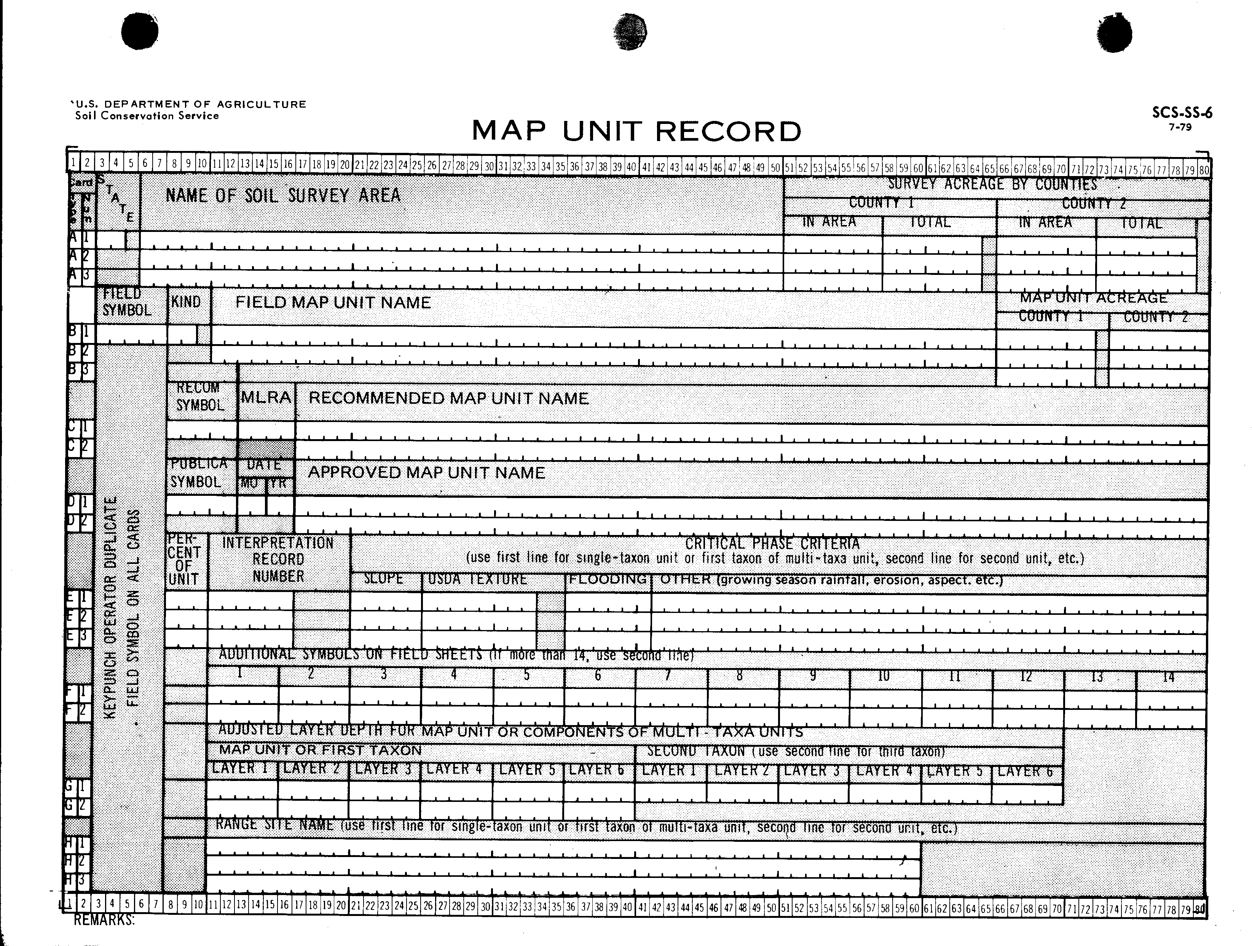
1974 – SOIL-6 Map Unit Record

Slide 9
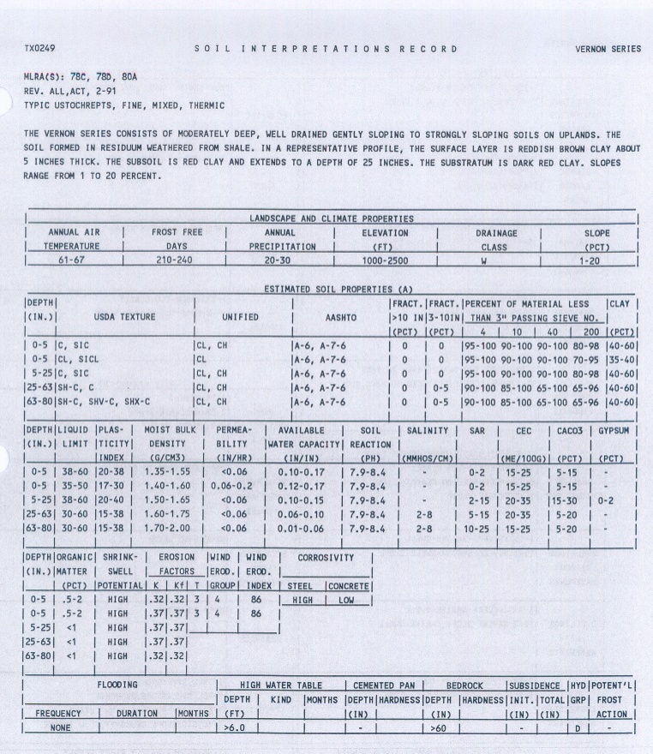
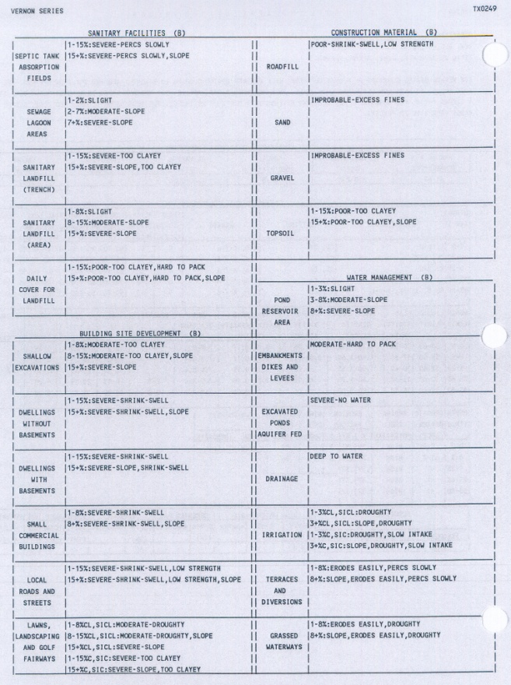
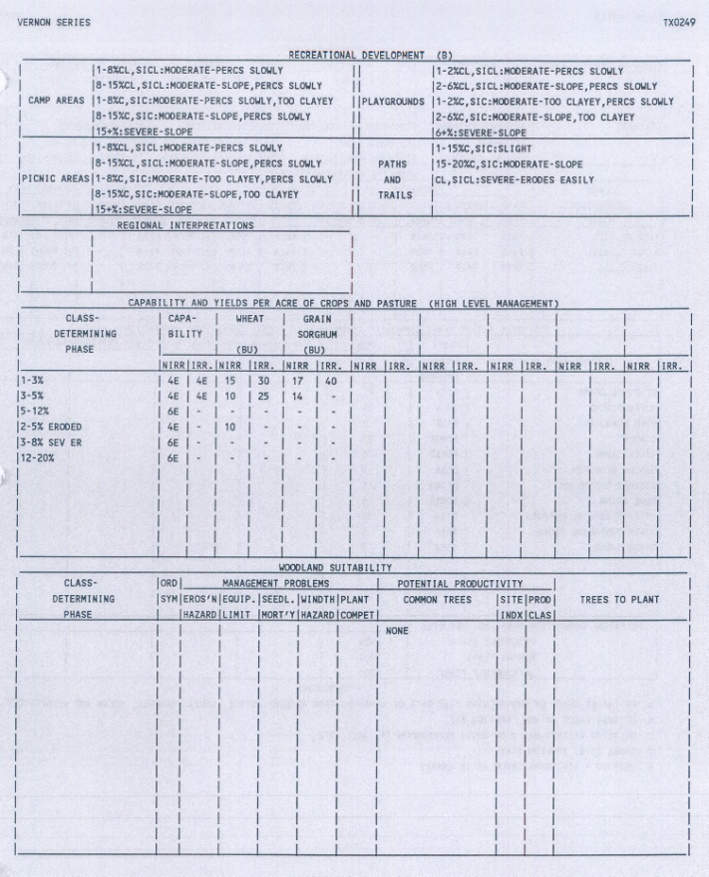
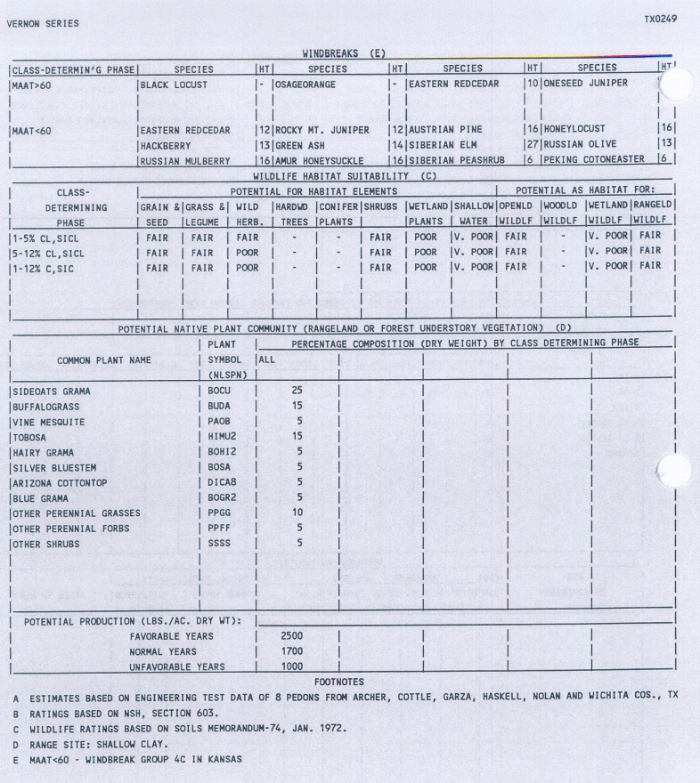
1972 - SOI-5 “Series Interpretation Record”
Later version with 4 pages
Notes:
The Form SOI-5 continued to evolve to a 4 page document. Additional fields were developed for the series phase criteria and additional interpretations. This particular SOI-5 is “TX0249” for the Vernon series.

Slide 10
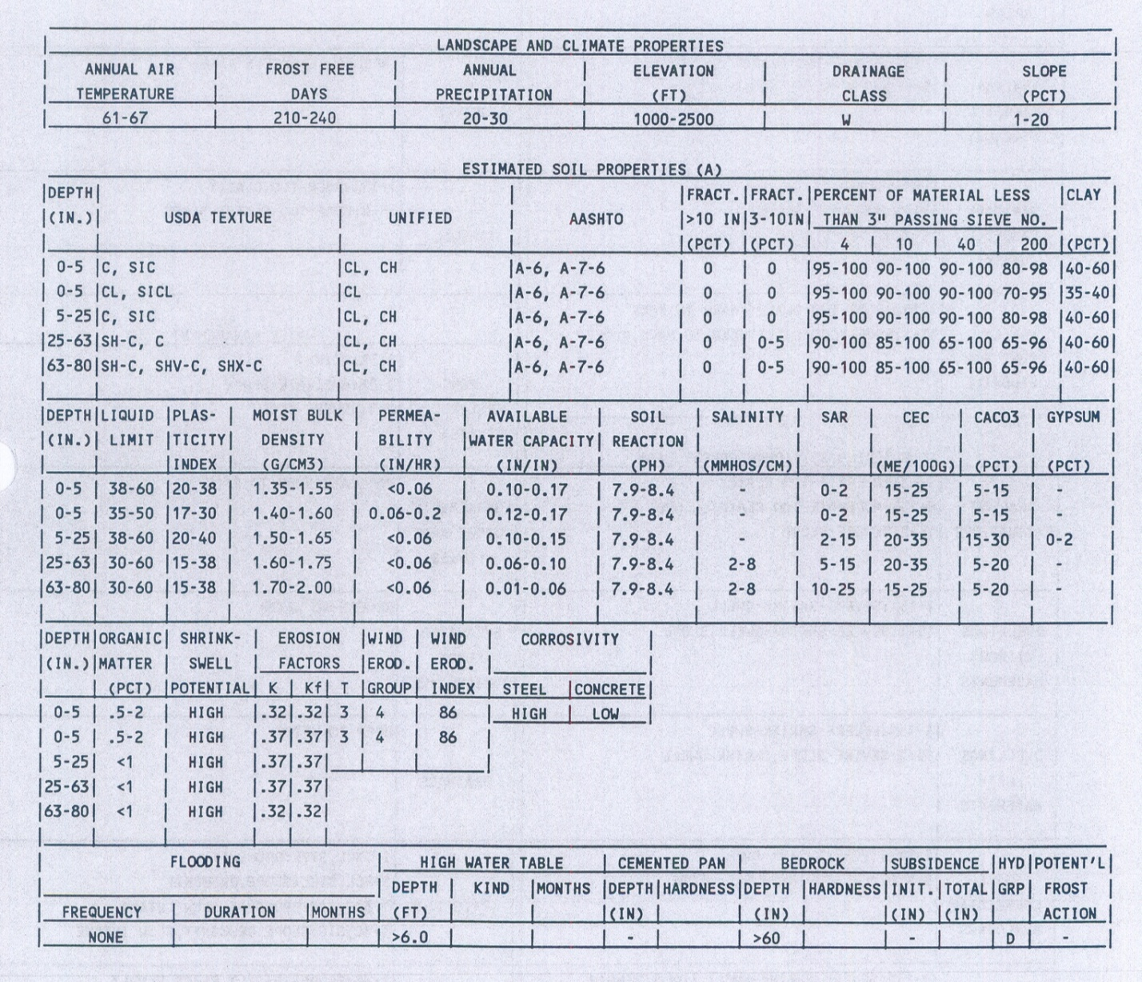
1972 - SOI-5 “Series Interpretation Record”
Maximum of 3 surface horizons
Maximum of 6 total horizons
Minimal Properties with Low and Highs
Notes:
A closer look at a later FORM SOI-5 identifies the few soil properties assigned to a series or phase. Notice the use of ranges, “Low” and “High”. The FORM SOI-5 limited the soil scientist to providing a maximum of 3 surface horizons to differentiate the distinct soil properties found during mapping a series. There was a limitation of 3 surface horizons that required the soil scientist to aggregate the pedon horizons into “layers”.

Slide 11
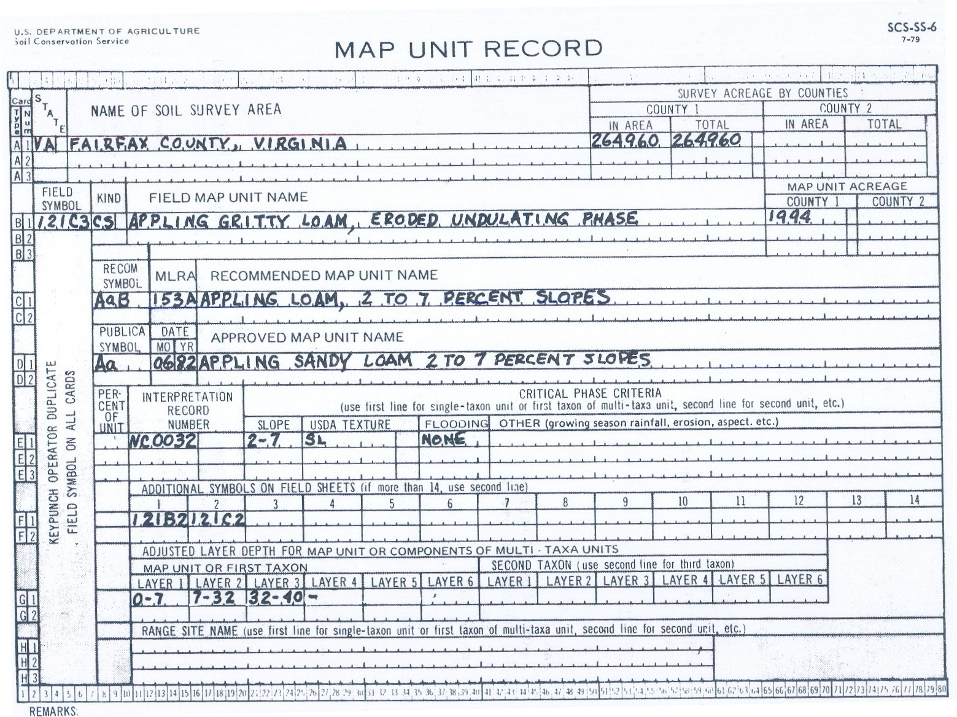
1974 – SOIL-6 Map Unit Record
Used to retrieve data for manuscript development
Maximum of 3 components for the map unit
Horizon layer depth adjusted to match county TP
Notes:
The Form SS-6, which later became the Form SOI-6, arrived about the same time as the “Form 5”. Once again, the form was a data entry form used to enter data into the ISU mainframe. The purpose was to retrieve property and interpretation tables for the soil survey manuscripts. The Form SOI-6 entered the map unit information. The survey area, map unit symbol, map unit names were entered, along with the map unit phase criteria. The form allowed a maximum of 3 components. The component “layers” could be “adjusted” to allow the depths to match the Taxonomic Unit Description for the survey area.
Additional information from “United States Soil Survey Databases” edited by J.R. Fortner and A.B. Price USDA-NRCS in 2009:” Computerization in SCS offices for processing soil survey data began in 1977 with Linolex word-processing equipment in SCS regional offices. This equipment was used to prepare manuscript tables received on magnetic tape from ISU for final publication. Remote access to ISU from SCS began in the early 1980s with Harris Remote Job Entry equipment in both state and regional offices. Communication was through 4800-baud dial-up commercial ports. This was a time of significant change as batch software had to be redesigned for remote usage and data entry. Processing and printing of manuscripts shifted from ISU to SCS offices.”

Slide 12
NASIS Foundation
1985 – Release of State Soil Survey Database
State control of data
Streamlined Database Management
Database created from Soi-5 and Soi-6
Database allowed printing of survey manuscript reports locally
Prelude database (flat files)
Notes:
From Unites States Soil Survey Databases: “In 1987, this effort produced the Computer Assisted Management and Planning System (CAMPS) field office software and the State Soil Survey Database (SSSD). SSSD, which used Prelude® RDBMS software, was the culmination of the SRIS effort.
With the release of SSSD, state SCS offices were equipped with UNIX computers. The SSSD software allowed the SCS state offices to manage their portion of the soil survey databases, which were downloaded from ISU via telecommunications. The primary function of the first release of SSSD was to clean up soil data and provide a download of the Map Unit Interpretation Record (MUIR) database to CAMPS. The first release of SSSD provided the ability to develop reports through standard database queries and manage nontechnical soil descriptions. With this software release also came the recognition that a soil scientist (soil dataset manager) position was needed at each SCS state office to manage the soil information system.
With SSSD, the SCS state offices could edit the soil map unit property and interpretation (MUIR) data at ISU and thus more accurately represent local conditions. The offices then returned a copy of the edited data to ISU. This editing capability provided for a national collection of MUIR data in 1993. SSSD releases in 1988 through 1993 added additional capabilities. “

Slide 13
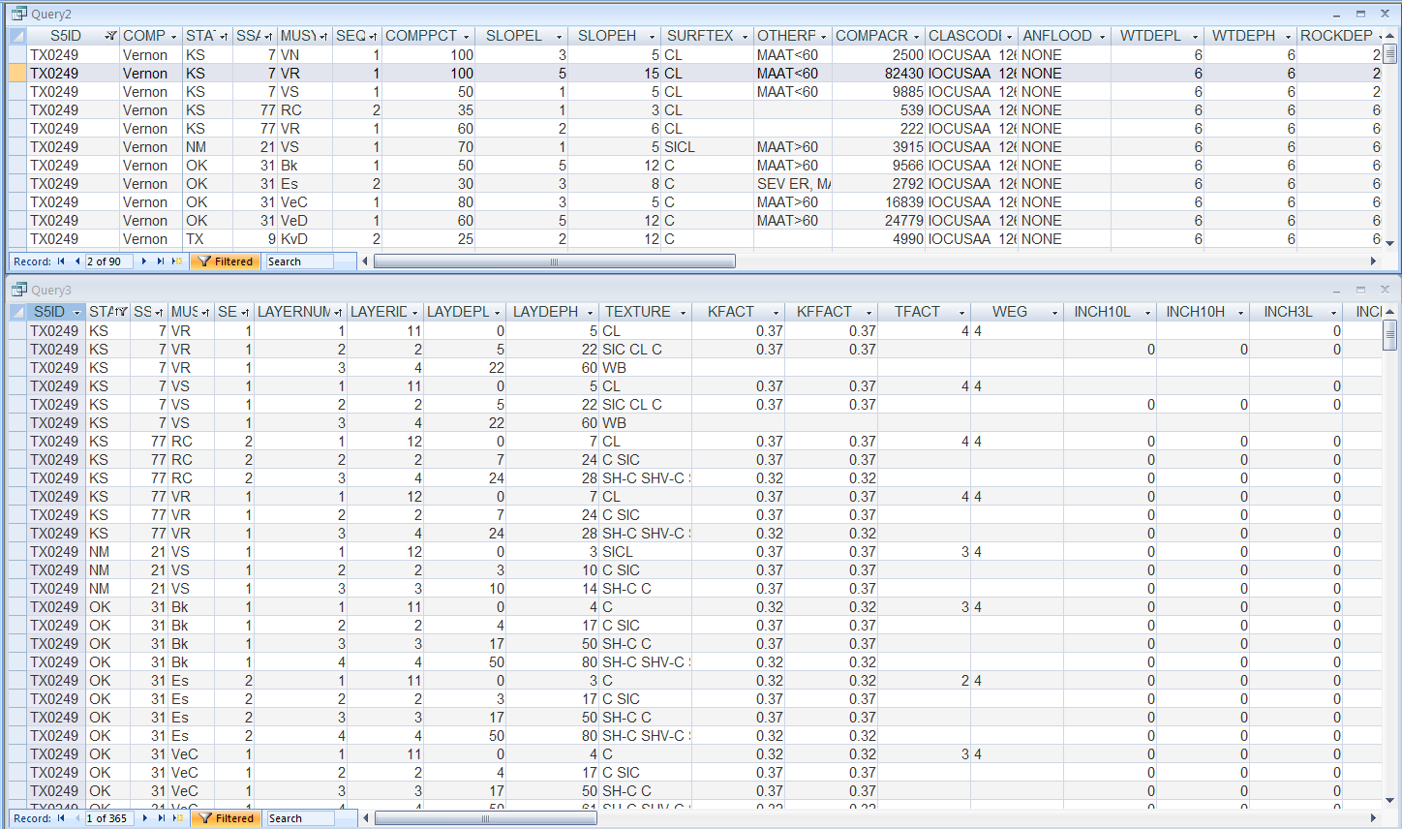
SOI-5 + SOI6 = MUIR
Map Unit Information Record - SSSD
Same S5id number for the same component used in various map units
Slight variations based on the S-5 Layer ID
Notes:
The only remaining 1993 archive of the Map Unit Interpretation Record (MUIR) is located on the computer of the National Database Manager in the National Soil Survey Center at Lincoln, Nebraska. It is now viewed using MS Access software. In this Access view, the “Component “ and “Layer” tables are used to view TX249; one of the Series Interpretation Records for the Vernon series. Notice the identification of LayerID “11” and “12”. Also notice the similarities of the data; all the data came from the same form SOI-5. The only variations are the layer depths entered on the SOI-6 for use in the specific county, and any specific phase criteria. Notice the differences for the eroded “ES” map unit.

Slide 14
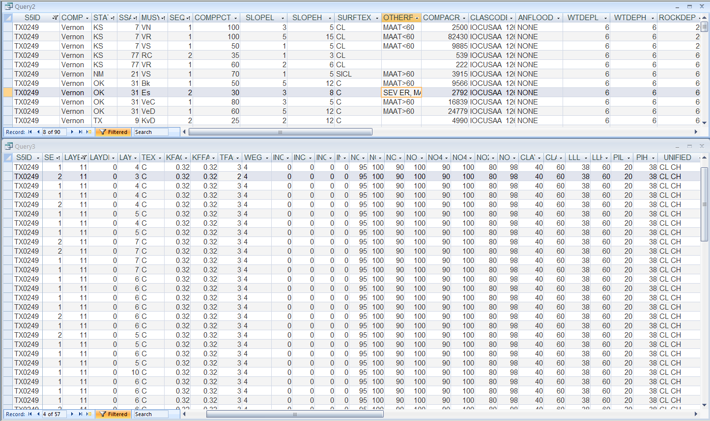
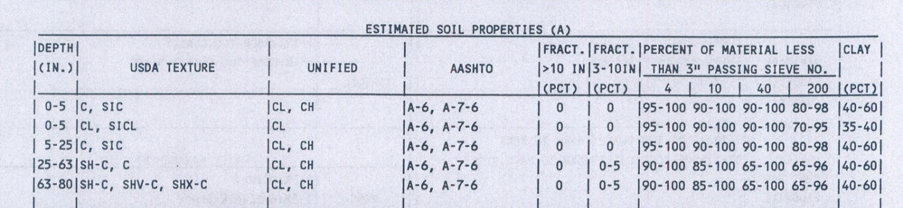
SOI-5 + SOI6 = MUIR
Map Unit Interpretation Record - SSSD
Only LayerID “11”
Notes:
Comparing the “MUIR” data to the SOI-5 data you will notice an exact duplicate for almost all of the data. Notice the Kansas data deviates slightly from the SOI-5 data. The SSSD had capabilities of direct editing of the data versus the process of the Forms SOI-5 and SOI-6 being modified, transmitted to ISU and retrieved from ISU. The SSSD provided the states the capability of printing manuscript reports locally. Editing the data locally and reporting the data locally improved the efficiency of publishing soil survey manuscripts. From “United States Soil Databases”: “Although table generation remained the primary purpose, the MUIR database soon began to be used for more than developing soil interpretation tables for reports. SCS began to use the database to answer questions on a wide range of soil-related issues across the United States, for example, the extent of salt-affected soils, soil loss tolerance and erosion potential for determination of highly erodible land, and, more recently, identification of hydric soils (wetlands). The uses of the soil database continued to expand and change until it became apparent in 1988 that SSSD and MUIR could not meet the changing needs. New information systems technology was available that could advance the use of soil survey information.”

Slide 15
NASIS Timeline
1989 – Planning SSSD replacement Needed:
Easier to use and more flexible database
New Data Elements
Interpretations run against actual soil properties
Data capture at field level (“bottom up” instead of “top down”)
New customizable Reports and Products
Multiple Components (S6 limit was 3)
Multiple Horizons (S5 limit was 6)
“RV”s - Representative Values for Modeling
Notes:
In 1989, a team was developed to plan the next phase of soil databases. From “United States Soil Databases” : “Development of NASIS began with the analysis and documentation of the business of soil survey from beginning to end. Teams from various levels in the NCSS were established to complete the requirements analysis. Using structured systems analysis, these teams documented requirements that were passed on to contract software programmers. This analysis documented the important shift of the NCSS from producing static, printed soil survey reports to providing a dynamic database of soil information that could meet a wide range of needs.
A field data collection system was needed to ensure the integrity and completeness of the data collected, including the geographic coordinates. The system was designed to provide users accurate and complete soil survey information based on what was observed during the soil survey process. Implicit in this idea was the ability to describe accurately the variability of soils and their properties as they occur on the landscape. This new system had to provide for a continuous update of the database as new information is gathered, so that one version of these data was available to users at the field, state, and national levels.”
“Many weeks of analysis (discussion) early on and numerous follow-up meetings identified the following specific system objectives (Soil Survey Staff, 1991):
• The placement of automated tools in the hands of front-line field office staff.
• One-time data entry, so that data could be retrieved by multiple software modules in various computer programs.
• A simple means of entering data in same format as that used during data collection.
• Validations to ensure proper entry of data and algorithms to provide default values.
• Automated procedures for correlation and quality assurance.
• Flexibility of the system to adapt to changes in procedure and standards and to new data needs and policies.
• Capability to aggregate large-scale digital soil maps to smaller scales based on user-defined criteria.
• Data manipulation and retrieval options for all databases and software modules that include modeling capability.
• The ability to use single property values or representative values in addition to ranges to be used in models.
• Capability to indicate confidence limits and the reliability of map unit data.
• Continuous update of national, state, and field office soil survey databases.
• Field access to state and national databases at the discretion of the users.
• Permanent storage of all soil survey documentation.
• Capability to transfer data files between various kinds of equipment.
• Two-way linkages to other natural resource databases.
• Software modules that are interactive, menu driven, and user friendly.
• Training on how to use the new system.”

Slide 16
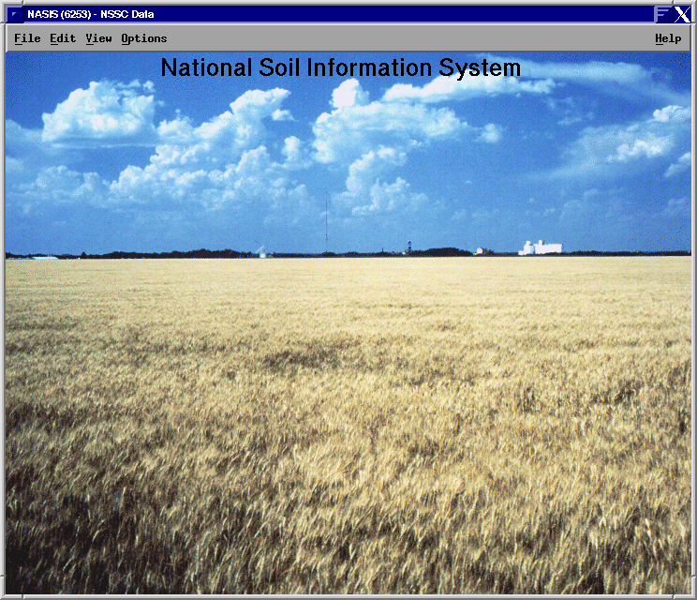
NASIS Timeline
1994 - NASIS 1.0
Conversion of data from SSSD
Basic editing capabilities
NASIS database in each state office
1995 - NASIS 2.0 (100 years of soil survey - $50B db)
Added query and report capability
Cut/copy/paste
Global edits
1996 - NASIS 3.0
Interpretation Generator added
Rules, Evaluations and Properties
Calculations and validations added
Geomorphic description tables
Notes:
On an annual release cycle NASIS was improved with new tools. NASIS separated the User Interface from the underlying database software. All editing was controlled through the user interface thereby adding security and integrity to the database. The initial release converted the existing “MUIR” data from the State Soil Survey Database into the Informix Database on a server located in each State Office.
In 1995, it was estimated the National Soil Information System database was valued at over $50 Billion dollars. Over 100 years of soil survey history now has a database in which to reside.

Slide 17
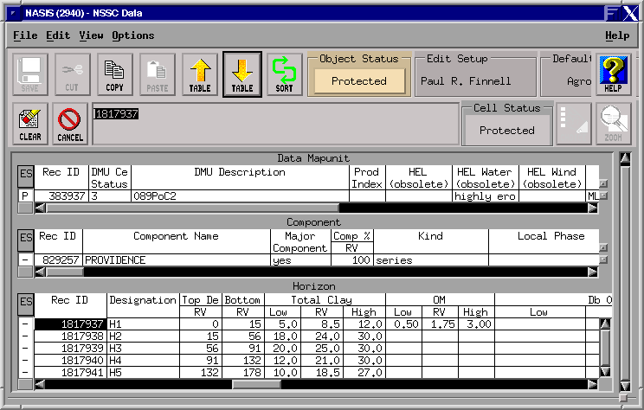
NASIS Timeline
1998 - NASIS 4.0
Site and Pedon data structure
Edit setups added
Replicated central database at ISU
Soil Survey Schedule integrated
2000 - NASIS 4.1
Finalized Site/pedon data structure to accommodate converting PDP data into NASIS
PDP pedon data converted into NASIS – November 2000
2001 - NASIS 5.0
Added SSURGO export capability
Consolidated database to central server
Notes:
The next major phase in the NASIS database was migrating all states databases to a central server located in Ames, Iowa. Additional tools were constantly being added to improve the national soils information system.

Slide 18
NASIS Timeline
2002 - NASIS 5.1
Added Null Hedges to interpretation generator
Link to ESIS for ecological sites – converted Component Ecosystem table data to Ecological Site and Component Ecological Site tables
Added Metadata Repository tables to manage NASIS data dictionary
2003 - NASIS 5.2
Staging Server, Soil Data Warehouse, Soil Data Mart implemented
SSURGO2 data model implemented
2005 - NASIS 5.3
Access to NASIS via eAUTH and Citrix
2007 – NASIS 5.4
Notes:
The annual release cycles continued to provide additional functionality. The ability to develop interpretations directly from NASIS against the actual data was a major step in reporting soils behavior. Linking to ESIS allowed for additional information from other resource staffs. The migration to using Citrix software solved many of the network issues that NASIS suffered from in the early years.

Slide 19
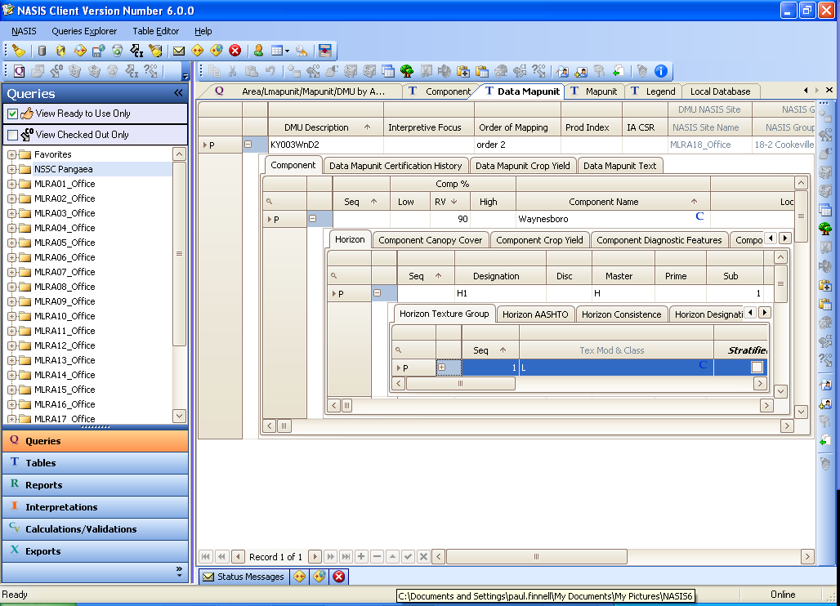
NASIS Timeline
2010 – NASIS 6.0
The goal was to have full functionality of previous versions 1.0 to 5.4
Migrated from Unix to .Net (Microsoft environment)
Migrated from Informix to SQL Server 2005
Converted from Server application to Client/Server application
Notes:
From “United States Soil Databases”: “Beginning in 2004, development of a new generation of NASIS began. This system is scheduled for release in 2009. It will be a Microsoft Windows® system using a .NET® operating system and SQL Server® DBMS. This version will begin managing data by projects rather than the traditional soil survey areas (usually county-based legends). This design will promote designing map units on the basis of their natural occurrence rather than limiting the spatial extent to geopolitical boundaries. As a result, properties, qualities, and interpretations of map units will extend across geopolitical boundaries to their full natural extent.”

Slide 20
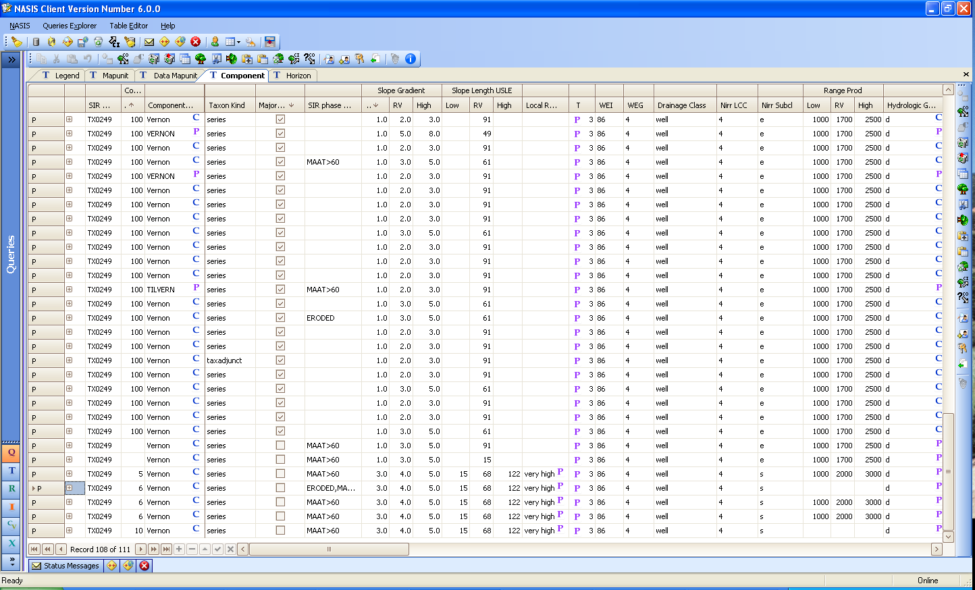
NASIS Foundation – where did this data come from?
Notes:
NASIS 6.0 has a new interface that mimics the use of Outlook, Excel and Access; all Microsoft software that many are familiar with using now. This screen shot contains the legend, Mapunit, Datamapunit, Component and Horizon tables listed as tabs in the Editor Panel. The Component table is opened and the data in the “selected set” is the Vernon series. The obsolete SIR field is on the left hand column identifying that all data is from the TX249 SOI-5. Data was selected using the SIR number. Notice the similarity of data after 15 years of NASIS.

Slide 21
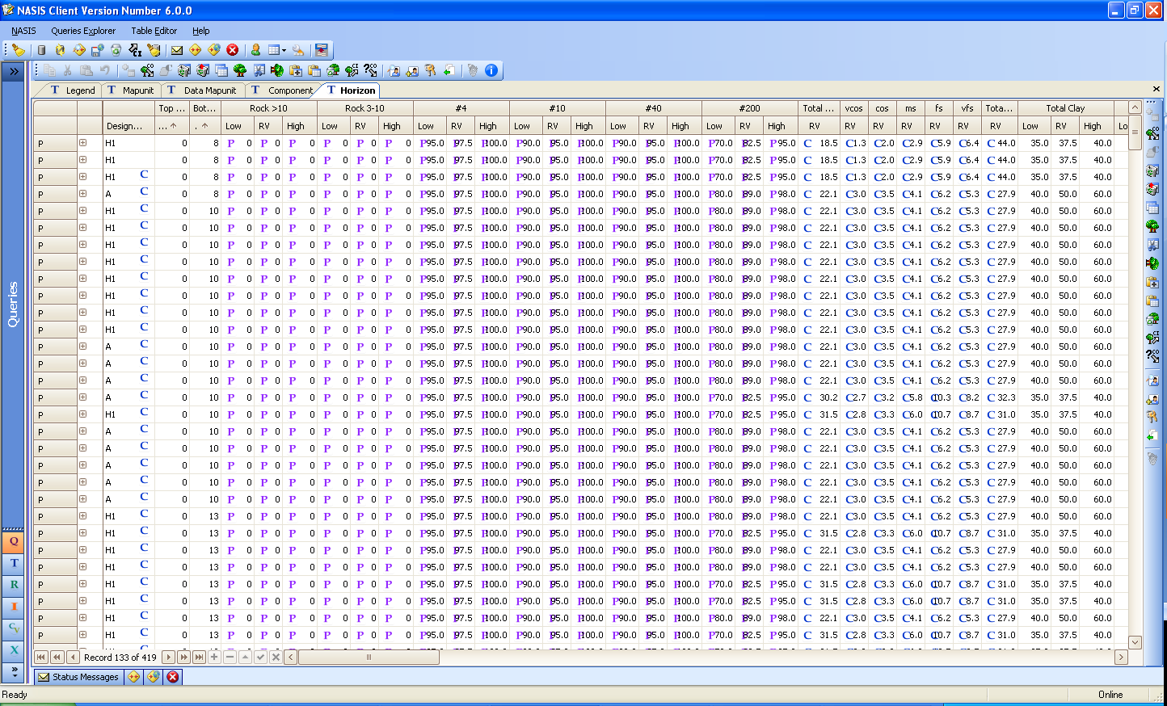
NASIS Foundation – notice any differences?
Notes:
Opening the Horizon table, and using the sorting and filtering capability of NASIS 6.0, the data is sorted on the Top Depth allowing all horizons with a top depth of “0” to appear. Notice the consistency of the TX0249 data in NASIS 6.0 even after 15 years. This consistency is due to the foundation of the NASIS data – it all came from the Soils-5. Yes, there are some who created new data, but the vast majority of the data in NASIS is the same data coming from the original same file.

Slide 22
Project Planning
NASIS 6.0 was designed to assist the updating by MLRA concept
Soil Surveys are managed using “Projects”.
Soil Surveys are published using “Legends”
The goal of the MLRA update is to bring similar named mapunits to a common standard
Notes:
NASIS 6 incorporated the split between Legends for publication and the Projects for management. The goal of the update is to bring the similar named mapunits to a common standard.

Slide 23
Updating Soil Surveys
The historical product was the soil survey manuscript.
Modern product are soil databases.
Notes:
Historically, Soil Scientists, when finished mapping a survey, spent time writing and publishing a manuscript. Today, Soil Scientists document everything in databases. It is imperative that text notes are used to explain the who, what, when, why, how and who cares? In the map unit text notes. The map unit concept of the new map unit MUST be written in the text notes.

Slide 24
Manuscript versus NASIS Review
Map unit concept is maintained in the manuscript. Manuscripts MUST be reviewed.
Original NASIS data was converted from the State Soil Survey Database (SSSD) - a series/phase concept (SOI5)
NASIS was designed to capture the component concept instead of being restricted to the SOI5 concept
Notes:
It is imperative to understand the need to rely on the manuscript as the foundation of soil information. The data in the NASIS database was converted from the SSSD. This database was populated with from the SOI5 and SOI6 data entry forms and these forms used a series concept, not a map unit concept. The properties on a SOI5 reflected the range of soil properties for the given series where ever it was mapped. Few states took the initiative to create SOI5 for each state much less each survey area in order to refine the soil properties based on a more local area of interest. Therefore, you can not rely on the NASIS database and assume if reflects how the series or how the map unit was originally mapped – the map unit concept – for the given survey area. The evaluation must consider the manuscript as the ultimate authority of the map unit concept.

Slide 25
Manuscript and NASIS Review
Manuscripts and NASIS should be critically and dependently reviewed
Update projects are to be designed to improve the existing product
Office re-correlations, with sufficient historical data (pedon, transect, lab data, correlation documents, manuscripts) should be acceptable
Notes:
It is important to understand the need to rely on the manuscript as the foundation of soil information and not the NASIS database. The data in the NASIS database was converted from the SSSD. This database was populated with from the SOI5 and SOI6 data entry forms and these forms used a series concept, not a map unit concept. The properties on a SOI5 reflected the range of soil properties for the given series where ever it was mapped. Few states took the initiative to create SOI5 for each state much less each survey area in order to refine the soil properties based on a more local area of interest. Therefore, you can not rely on the NASIS database and assume if reflects how the series or how the map unit was originally mapped – the map unit concept – for the given survey area. The evaluation must consider the manuscript as the ultimate authority of the map unit concept.

Slide 26
Update Vision
First Update is Attribute Database
Reconcile map unit names across political boundaries
Assign new national symbols for similar map unit concepts
All map unit evaluations are to be completed before development of Projects
Fully populate the Major components and all “strongly contrasting” Minor components
Many projects will be office re-correlations
Notes:
Many are still trying to understand the goal of the MLRA update. The update has been divided in two parts to focus the needs of the soil survey. The first update will focus on improving the quality of the attribute database. The intent is to fully populate all components, the major components and their strongly contrasting minor components. The database should be populated well enough so that each component can be located on the landform. Named minor components are the priority and fully populated major components can be copied and pasted to fully populate a DMU with all components. The attribute database must be reviewed and populated to produce a seamless coverage. This will include a review of all map units within the MLRA and reconciling the map unit names. Much of this work is completed using historical documentation. A thorough review of the like map units and their DMUs will uncover similar datasets for each map unit. The goal is not so much to “generalize” the data but to make the data flow creating a seamless coverage.
The second update will then utilize the attribute database to refine the line work, or raster. Understanding the components, where they occur and their basic soil properties will be critical for the second update.

Slide 27
Update Vision
Second Update is Spatial Database
Spatial update will use a fully populated attribute database
Spatial tools will be available in the future to improve the spatial product
Notes:
Many are still trying to understand the goal of the MLRA update. The update has been divided in two parts to focus the needs of the soil survey. The first update will focus on improving the quality of the attribute database. The intent is to fully populate all components, the major components and their strongly contrasting minor components. The database should be populated well enough so that each component can be located on the landform. Named minor components are the priority and fully populated major components can be copied and pasted to fully populate a DMU with all components. The attribute database must be reviewed and populated to produce a seamless coverage. This will include a review of all map units within the MLRA and reconciling the map unit names. Much of this work is completed using historical documentation. A thorough review of the like map units and their DMUs will uncover similar datasets for each map unit. The goal is not so much to “generalize” the data but to make the data flow creating a seamless coverage.
The second update will then utilize the attribute database to refine the line work, or raster. Understanding the components, where they occur and their basic soil properties will be critical for the second update.

Slide 28
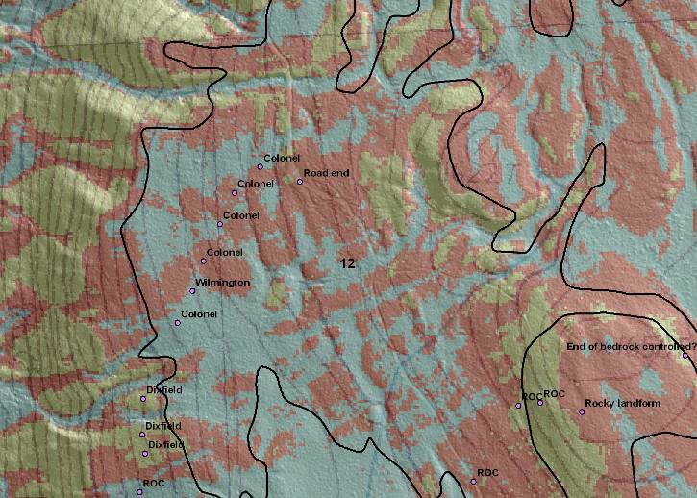
Why Tabular First?
Spatial (Hyperspectral or LiDAR) should be available for the entire USA in 5-7 years. The agency is pursuing national coverage of LiDAR like we did a few years back with ortho.
Notes:
Here is an example of raster based modeling for an initial survey in Vermont. This survey used the SIE model to identify the components within the landscape. Ground truthing methods were used to identify the soils and assign their properties. The Soils Division is moving to a Raster based map – this will provide many more tools that can be used to improve the original product, but the need for the components and their data populated in NASIS is needed, FIRST. We must have a good idea of the components found in the map units and where those components occur on the landform.

Slide 29
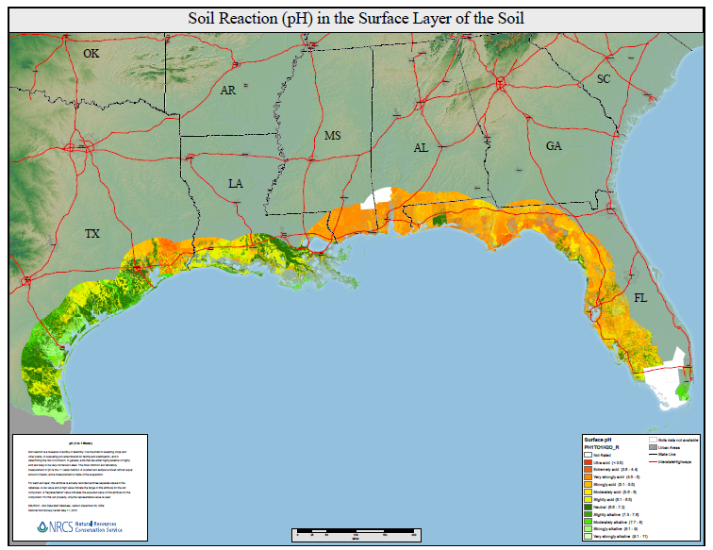
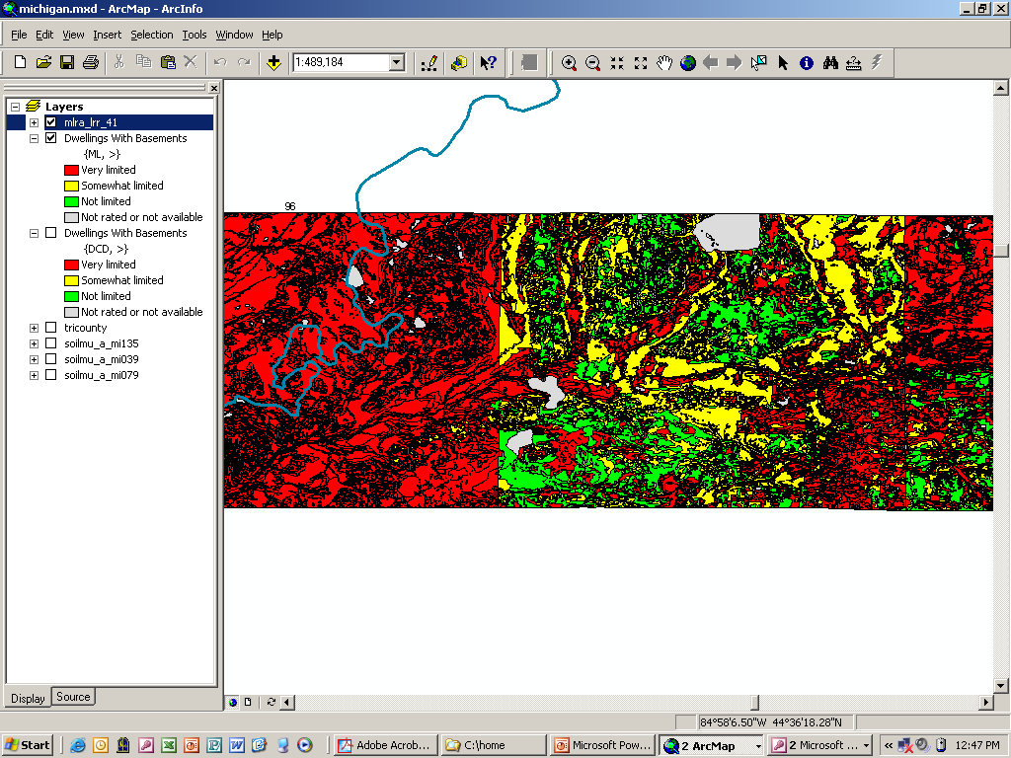
Why Tabular First?
We now have the tools to easily identify where the “Frankensteins” located along county and state boundaries. All users see the issue of making a soil survey for over 110 years. They want the discrepancies dealt with and it will make a great way to show improvement in the products.
Notes:
Here are two examples where county line joins are obvious and in need of update. The example on the right uses SDV to create interpretative and property maps. The second example was used for the Deepwater project and the red arrow shows an obvious bust in the soil properties within one Florida county. Focusing on the soil properties will improve the quality of the soil survey.

Slide 30
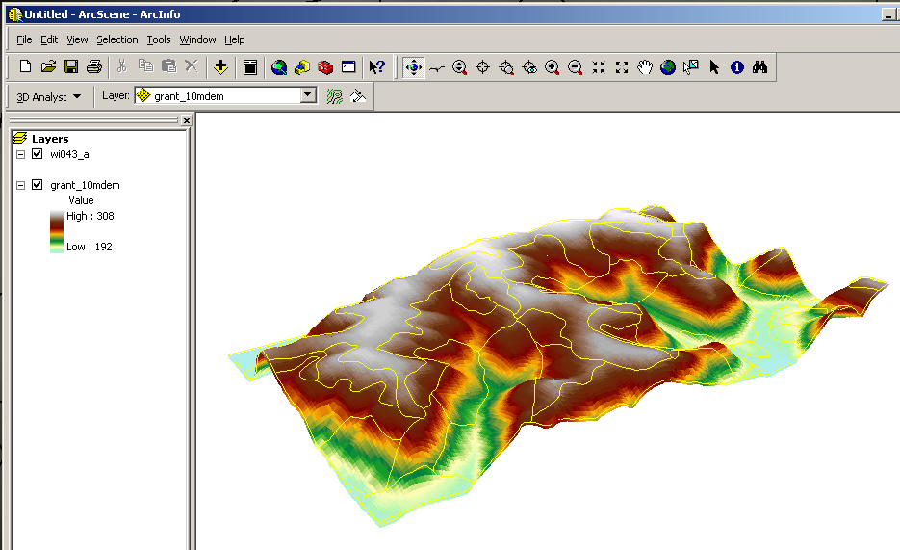
Why Tabular First?
Geospatial mapping tools that use the traditional vector/polygon soil lines hopefully will be fully developed so a model will be used to drape the existing soil lines more accurately along the soil-scape without having to use manual GIS and do it more automatically.
Notes:
Tools are currently being used to drape the soils lines on to the landscape image. Tools are constantly being developed and improved providing the ability to enhance the line work. Having a fully populated set of components will add to the ability of querying the GIS and improving the spatial product.

Slide 31
Why Tabular First?
During the next 5 years we will be looking at how to start using raster based soil survey information.
There is already the 30 meter resolution of existing SSURGO and soon with 10 meter resolution of SSURGO.
So decisions are needed on how to manage raster soil survey with new soil interpretations and how to serve this new product to our customers.
Notes:
See next slide

Slide 32
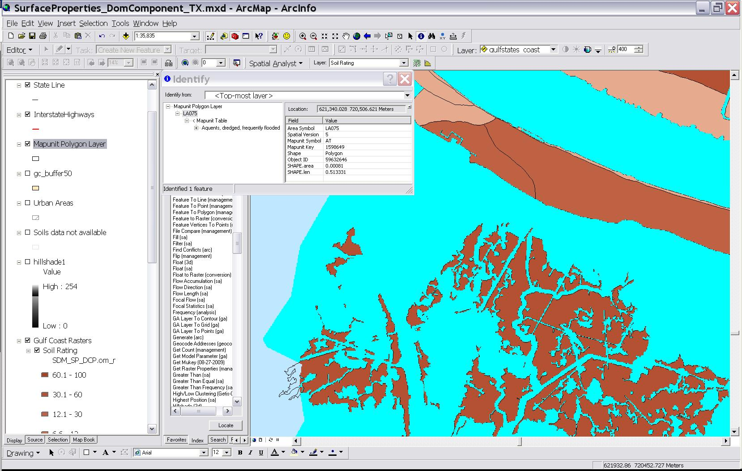
Why Tabular First?
During the next 5 years we will be looking at how to start using raster based soil survey information. We are already doing the 30 meter resolution of existing SSURGO and soon with 10 meter resolution of SSURGO. So we now need to decide how to manage raster soil survey with new soil interpretations and how to serve this new product to our customers.
Notes:
This is an example of the use of 30 meter raster of the SSURGO product. In this example the blue area are a mapunit named “Aquents”. The map is a raster product developed to identify the impact of the Deepwater oil spill on the Gulf Coast. One would think that a frequently flooded soil on the Gulf would have soil properties, however in this image the map unit AT the Organic Matter is not populated.

Slide 33
So, where do I start?
Read the book – read the manuscripts, the map unit concept is found in the book
Identify the Top 25 mapunits
And the Top 25 series
Reconcile map unit names
Compile a new map unit concept for the MLRA
Notes:
Read the book – what more can be said? The manuscripts contain the original map unit concepts that the mappers used to create the survey. Remember that each survey was mapped independently of another and at different times. Use that information to your advantage and compare similar map units. Compare what was mapped across county lines and make correlation decisions based on existing information. Then compare the database information and build a new set of data based on the MLRA. – And, populate everything.

